Slide 1
Lesson 9: Network Protocols
Mack 2023
Notes:
Last updated 30-11-2021
Resources are updated regularly — the latest version is available at: ncce.io/tcc.
This resource is licensed under the Open Government Licence, version 3. For more information on this licence, see ncce.io/ogl.

Slide 2

Rules for communication
Starter activity
Question
Can you think of any rules for communication that we use in our daily lives?
Explorer task
What would happen if we didn’t have rules for communication?
Notes:
Image source: Hands Thumb Promise - Free photo on Pixabay

Slide 3
Rules for communication
Starter activity
Saying hello and goodbye
Shaking hands
Waiting for someone to finish talking before you talk
Waving hello and goodbye
Using Dear etc. in letters and emails
Speaking the same language or one that both parties understand
Notes:
Image source: Hands Thumb Promise - Free photo on Pixabay

Slide 4
What if we didn’t have rules for communication?
Starter activity
Exchanges might be awkward if one person waves hello and the other person doesn’t
Several people might talk at once
You wouldn’t know how to politely end a conversation
People might be offended
People wouldn’t be able to understand each other
Notes:
Image source: Hands Thumb Promise - Free photo on Pixabay

Slide 5

Lesson 9: Protocols
Objectives
In this lesson, you will:
Determine the need for standards in network communications
Define the term network protocol
Define the purpose and common use of the network protocols: ethernet, WiFi, HTTP, HTTPS, FTP, POP, SMTP, and IMAP

Slide 6
Protocols
Activity 1
We use rules for communication in our daily lives. Computers also need to have rules for communication.
These are known as protocols.
You will have heard of a few network protocols already in this unit.
Internet protocol
TCP/IP suite of protocols
Routing protocols

Slide 7
Protocols
Activity 1
Protocols are needed for all sorts of reasons. Here are some examples:
Planning the routes
Establishing communication
Send and receiving data
Communicating securely
Opening web sites
Internet protocol
TCP/IP suite of protocols
Routing protocols

Slide 8

Protocols
Activity 1
Protocols are the reason why billions of devices all over the world can communicate with each other.
They all follow the same protocols!
Notes:
Image source: Earth Network Blockchain - Free image on Pixabay

Slide 9
Protocols
Activity 1
Common protocols used in networking are:
Ethernet
WiFi
HTTP/S
FTP
POP
SMTP
IMAP
Notes:
Image source: Earth Network Blockchain - Free image on Pixabay

Slide 10
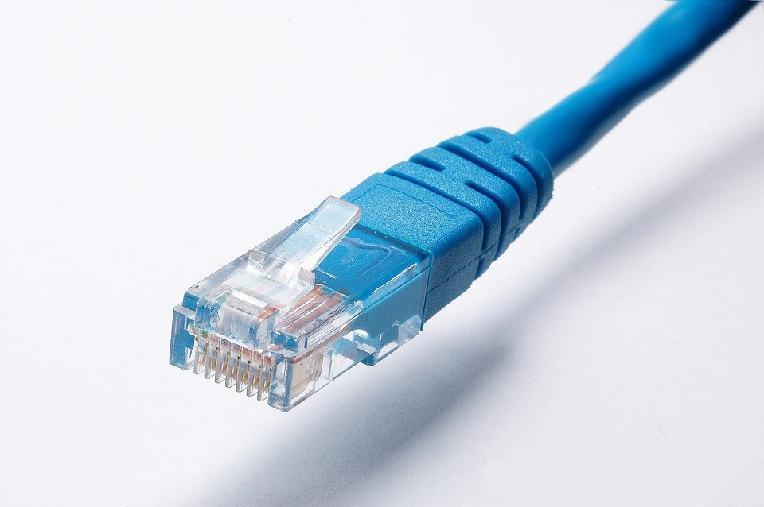
Ethernet
Activity 1
You may have heard the term ethernet cable before.
An ethernet cable can be used to describe the copper and fibre optic cables that you covered in earlier lessons.
Notes:
Image source: Network Cable - Free photo on Pixabay

Slide 11

Ethernet
Activity 1
Ethernet isn’t just a type of cable. It is a suite of protocols used in a wired network.
Any network hardware that uses the ethernet protocols will work with any other hardware that uses the ethernet protocols.
Notes:
Image source: Offices Business Computer - Free photo on Pixabay

Slide 12

WiFi
Activity 1
WiFi is a suite of protocols used in wireless communication.
It enables the transmission of data through radio signals.
WiFi uses a specific range of radio wave frequencies (also called frequency bands) to transmit data.
Notes:
Image source: Wifi Access Internet - Free vector graphic on Pixabay

Slide 13
WiFi – Common Misconception
Activity 1
The majority of internet users connect to their Local Area Network via WiFi and are unaware of the rest of the technology that enables the internet to work.
They see the internet as their wireless connection. When they are unable to access a web site or use a service they often blame the WiFi and say the “WiFi is down”.
Notes:
Image source: Wifi Access Internet - Free vector graphic on Pixabay

Slide 14
WiFi – Common Misconception
Activity 1
The internet could not be working for any of the following reasons:
Connection to ISP is not working
DNS is not working
Web server’s network is down
The web server is unavailable / overloaded
The connection to the ISP is overloaded
Delays anywhere in the network
Or… it may be that your WiFi is down .
Notes:
Image source: Wifi Access Internet - Free vector graphic on Pixabay

Slide 15

HTTP and HTTPS
Activity 1
You might have noticed HTTP or HTTPS before a website address in your browser.
HTTP stands for Hypertext Transfer Protocol. It is a protocol that is used to identify, request, and transfer web pages across the internet.
Notes:
Image source: Https Website Internet - Free image on Pixabay

Slide 16
HTTP and HTTPS
Activity 1
HTTPS is a secure version of this protocol that adds in extra protection for the data that is transmitted.
Notes:
Image source: Https Website Internet - Free image on Pixabay

Slide 17
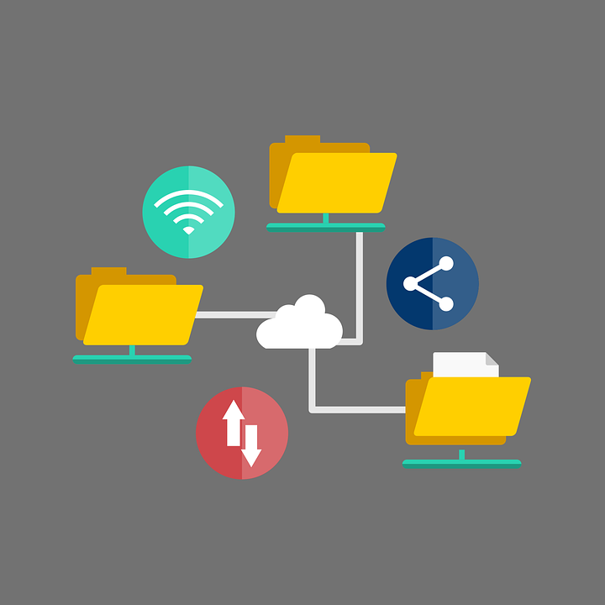
FTP
Activity 1
FTP stands for file transfer protocol. It deals with uploading and downloading files from a server.
FTP is sometimes used for uploading personal web pages to a web server.
It is also used to deal with other types of files like PDFs and images.
Notes:
Image source: Folder Network File - Free vector graphic on Pixabay

Slide 18
FTP
Activity 1
An FTP server will typically give the user more control over the navigation of files on the server in comparison to HTTP.
Users can often view directories and choose which files to download and where to upload files.
FTP servers must be very secure and a username and password is typically required to access them.
Notes:
Image source: Folder Network File - Free vector graphic on Pixabay

Slide 19

POP, IMAP, and SMTP
Activity 1
POP, IMAP, and SMTP protocols all deal with email communications.
POP stands for post office protocol. This type of email protocol is less common nowadays.
Notes:
Image source: Email Newsletter Marketing - Free vector graphic on Pixabay

Slide 20
POP, IMAP, and SMTP
Activity 1
The POP protocol retrieves the email from the email server, delivers it to your computer or device, and then deletes it from the email server.
Once you download the email, it only exists on your device and is not backed up on a server.
Notes:
Image source: Email Newsletter Marketing - Free vector graphic on Pixabay

Slide 21
POP, IMAP, and SMTP
Activity 1
IMAP stands for internet message access protocol.
IMAP retrieves the email from the email server but also leaves a copy of it on the remote server.
This is helpful if you want to view your emails on your phone and also view them in a web browser.
Notes:
Image source: Email Newsletter Marketing - Free vector graphic on Pixabay

Slide 22
POP, IMAP, and SMTP
Activity 1
SMTP stands for simple mail transfer protocol.
This protocol deals with sending an email to an email server.
Notes:
Image source: Email Newsletter Marketing - Free vector graphic on Pixabay

Slide 23
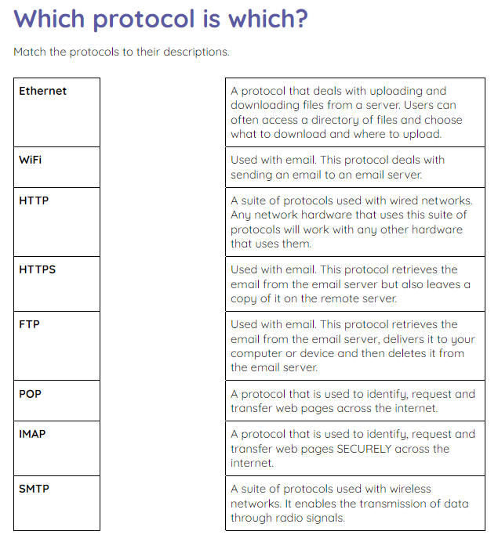
Which protocol is which?
Activity 1
Use the activity 1 sheet to see how many network protocols you can remember.
Try to match the protocols to their descriptions.

Slide 24
Which protocol is which? Solutions
Activity 1
Ethernet | A suite of protocols used with wired networks. Any network hardware that uses this suite of protocols will work with any other hardware that uses them.
WiFi | A suite of protocols used with wireless networks. It enables the transmission of data through radio signals.
HTTP | A protocol that is used to identify, request, and transfer web pages across the internet.
HTTPS | A protocol that is used to identify, request, and transfer web pages SECURELY across the internet.

Slide 25
Which protocol is which? Solutions
Activity 1
FTP | A protocol that deals with uploading and downloading files from a server. Users can often access a directory of files and choose what to download and where to upload.
POP | Used with email. This protocol retrieves the email from the email server, delivers it to your computer or device, and then deletes it from the email server.
IMAP | Used with email. This protocol retrieves the email from the email server but also leaves a copy of it on the remote server.
SMTP | Used with email. This protocol deals with sending an email to an email server.

Slide 26
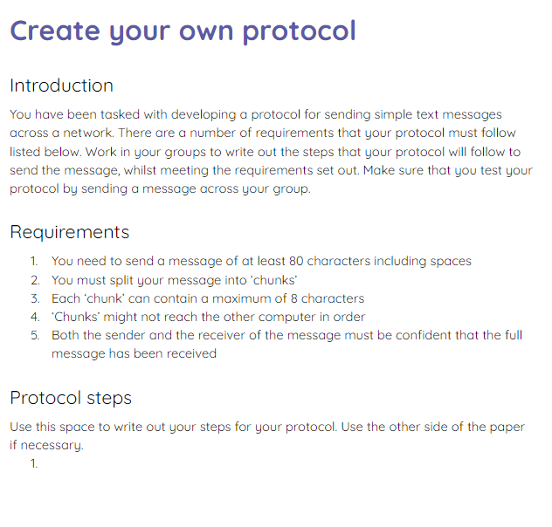
Create your own protocol
Activity 2
In your groups, develop your own protocol for sending an 80 character message across a network.
Use the activity 2 sheet for guidance.

Slide 27
Tell us about your protocol
Wrap Up
In your groups:
Explain how your protocol worked
Describe how successful or unsuccessful it was

Slide 28
Next lesson
Summary
In this lesson, you…
Learnt about some of the main protocols used for communication
Next lesson, you will…
Learn about the TCP/IP model

